Slide 1
ChemE 599: Image Analysis for Scientists and Engineers
Lecture 0: Course Overview
Prof. Chad Curtis
Mar. 30, 2020

Slide 2
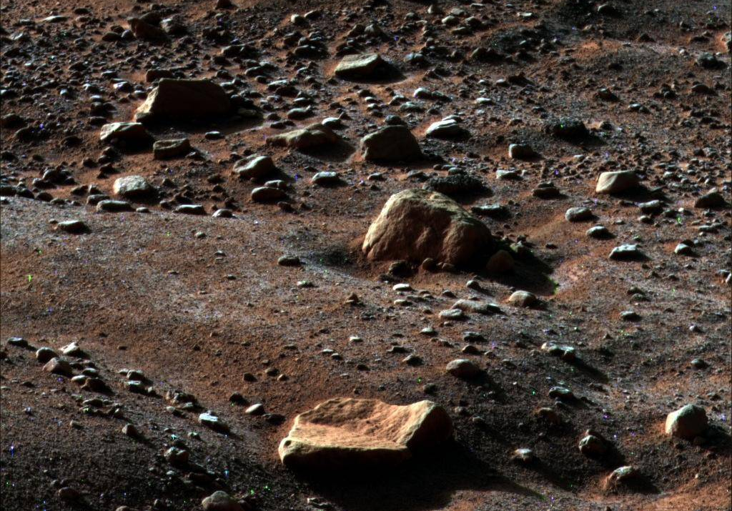
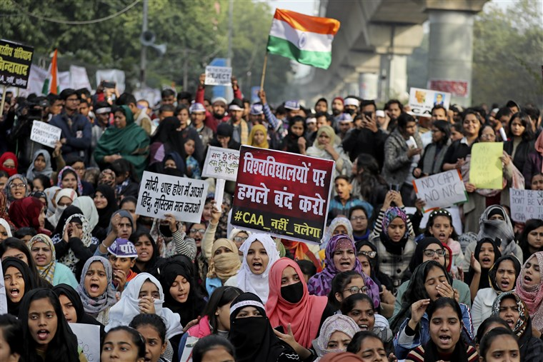
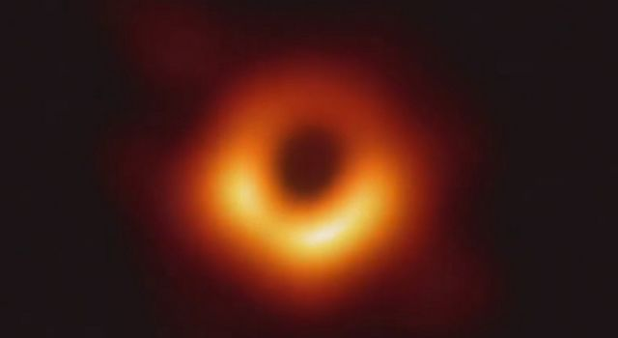
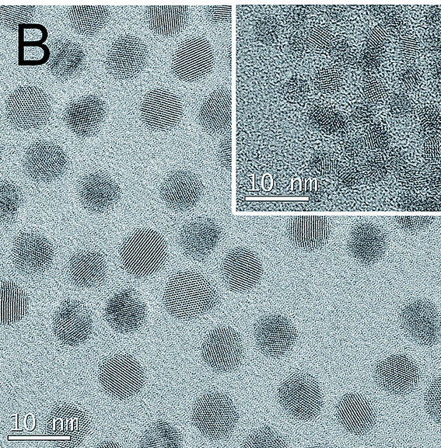
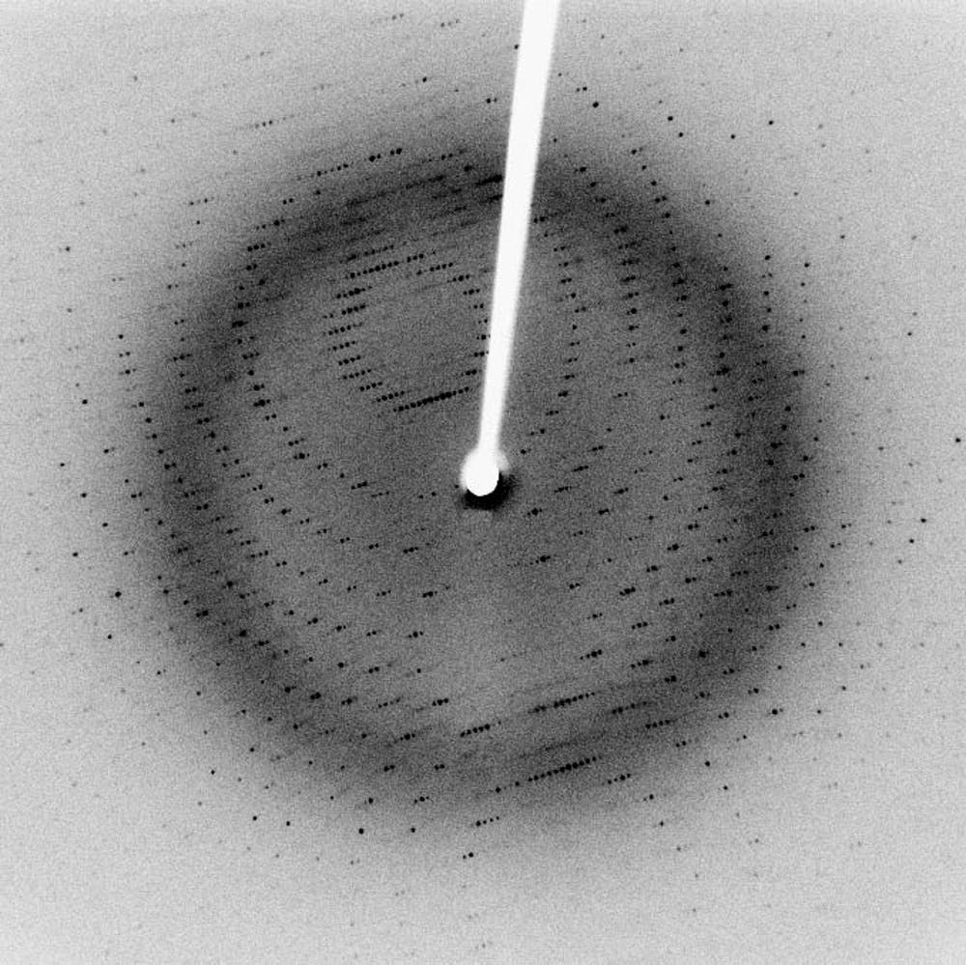
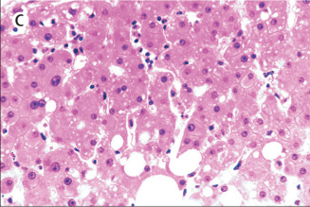
Images as Data
Notes:
Image 1: Frost on Mars, take from the Phoenix rover
Image 2: Quantum dots taken from Mengying
Image 3: Liver tissue of COVID-19 patient
Image 4: X-ray crystallography
Image 5: Black hole
Image 6: Twitter/violence study

Slide 3
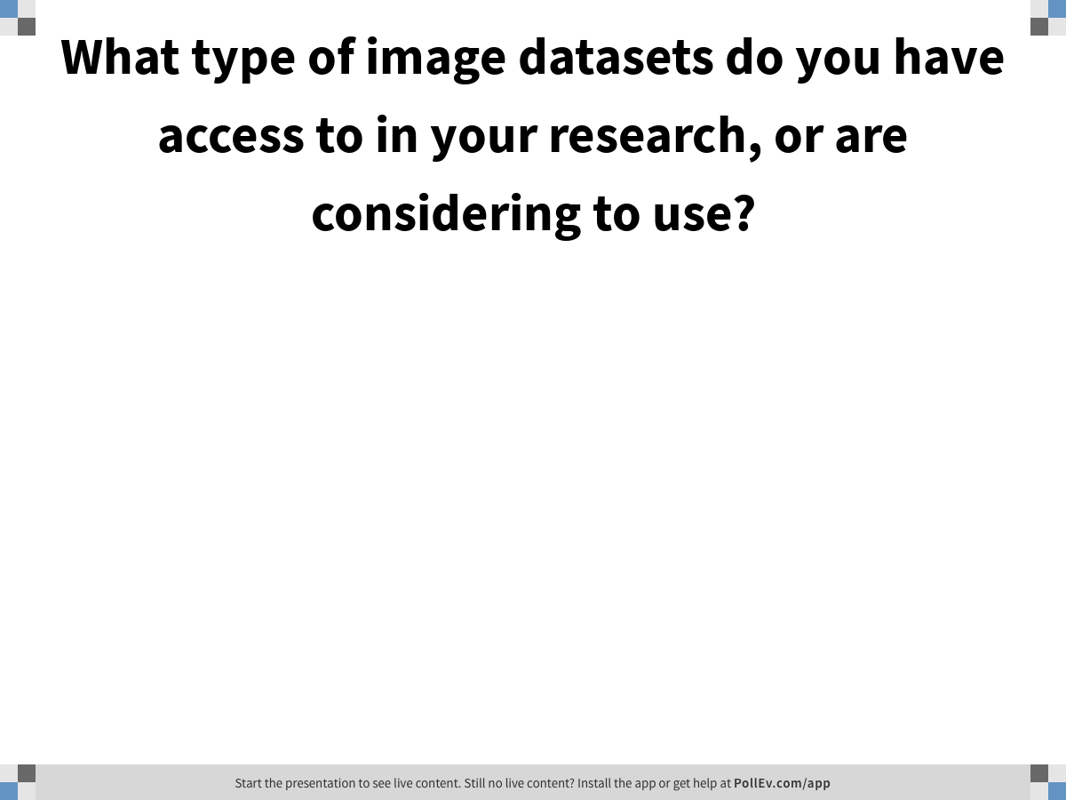
Notes:
Poll Title: What type of image datasets do you have access to in your research, or are considering to use? https://www.polleverywhere.com/free_text_polls/mRTLpInvn7fpZv0KNcelZ

Slide 4
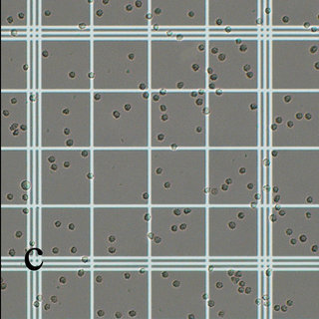
Hemocytometer images: Image morphology
Problem: I have hundreds of hemocytometer images to perform cell counts, but I think I could make this process much quicker if I could automate the process.
Possible solutions: binarize image into cells (black) and background (white); Canny edge detector
Problems: False positives (objects that are not cells counted as cells); false negatives (cells missed); overlapping cells; what threshold to use; non-uniform lighting

Slide 5
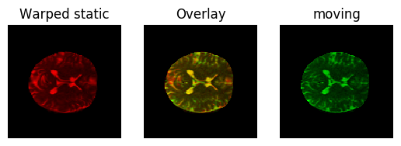
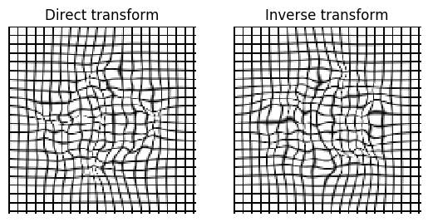
Neuroanatomical Datasets: Image registration
Problem: I am trying to compare stacks of MRI images of different patients, but I can’t compare them directly because they have different frames of reference.
Possible solutions: diffeomorphic image registration
Problems: Images aren’t similar enough, images are too big to process effectively

Slide 6
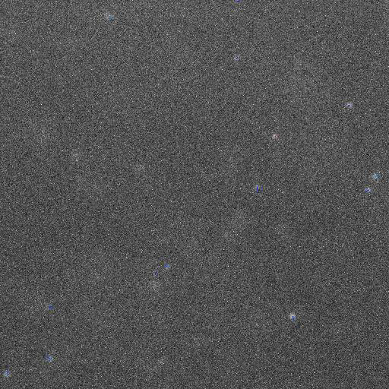
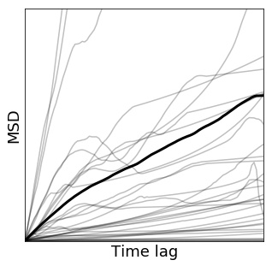
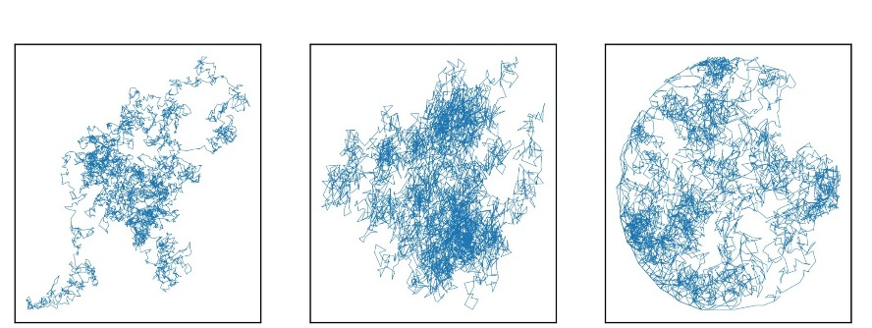
Diffusing nanoparticles: Feature tracking and machine learning
Problem: I have videos of nanoparticles diffusing in different conditions, and I want to quantify the differences in their behavior.
Possible solutions: feature identification and tracking
Problems: false positives, false negatives, frame rate, objects leaving frame

Slide 7
Quantify tissue damage: Object recognition

